Slide 1
Chapter 14
Advanced Normalization

Slide 2
Chapter 14 - Objectives
How inference rules can identify a set of all functional dependencies for a relation.
How Inference rules called Armstrong’s axioms can identify a minimal set of useful functional dependencies from the set of all functional dependencies for a relation.

Slide 3
Chapter 14 - Objectives
Normal forms that go beyond Third Normal Form (3NF), which includes Boyce-Codd Normal Form (BCNF), Fourth Normal Form (4NF), and Fifth Normal Form (5NF).
How to identify Boyce–Codd Normal Form (BCNF).
How to represent attributes shown on a report as BCNF relations using normalization.

Slide 4
Chapter 14 - Objectives
Concept of multi-valued dependencies and Fourth Normal Form (4NF).
The problems associated with relations that break the rules of 4NF.
How to create 4NF relations from a relation, which breaks the rules of to 4NF.

Slide 5
Chapter 14 - Objectives
Concept of join dependency and Fifth Normal Form (5NF).
The problems associated with relations that break the rules of 5NF.
How to create 5NF relations from a relation, which breaks the rules of 5NF.

Slide 6
More on Functional Dependencies
The complete set of functional dependencies for a given relation can be very large.
Important to find an approach that can reduce the set to a manageable size.

Slide 7
Inference Rules for Functional Dependencies
Need to identify a set of functional dependencies (represented as X) for a relation that is smaller than the complete set of functional dependencies (represented as Y) for that relation and has the property that every functional dependency in Y is implied by the functional dependencies in X.

Slide 8
Inference Rules for Functional Dependencies
The set of all functional dependencies that are implied by a given set of functional dependencies X is called the closure of X, written X⁺ .
A set of inference rules, called Armstrong’s axioms, specifies how new functional dependencies can be inferred from given ones.

Slide 9
Inference Rules for Functional Dependencies
Let A, B, and C be subsets of the attributes of the relation R. Armstrong’s axioms are as follows:
(1) Reflexivity
    If B is a subset of A, then A → B
  (2) Augmentation
  If A → B, then A,C → B,C
  (3) Transitivity
  If A → B and B → C, then A → C

Slide 10
Inference Rules for Functional Dependencies
Further rules can be derived from the first three rules that simplify the practical task of computing X+. Let D be another subset of the attributes of relation R, then:
(4) Self-determination
A → A
(5) Decomposition
If A → B,C, then A → B and A → C

Slide 11
Inference Rules for Functional Dependencies
(6) Union
If A → B and A → C, then A → B,C
(7) Composition
If A → B and C → D then A,C → B,D

Slide 12
Minimal Sets of Functional Dependencies
A set of functional dependencies Y is covered by a set of functional dependencies X, if every functional dependency in Y is also in X+; that is, every dependency in Y can be inferred from X.
A set of functional dependencies X is minimal if it satisfies the following conditions:
  Every dependency in X has a single attribute on its right-hand side.

Slide 13
Minimal Sets of Functional Dependencies
  We cannot replace any dependency A → B in X with dependency C → B, where C is a proper subset of A, and still have a set of dependencies that is equivalent to X.
  We cannot remove any dependency from X and still have a set of dependencies that is equivalent to X.

Slide 14
Boyce–Codd Normal Form (BCNF)
Based on functional dependencies that take into account all candidate keys in a relation, however BCNF also has additional constraints compared with the general definition of 3NF.
Boyce–Codd normal form (BCNF)
  A relation is in BCNF if and only if every determinant is a candidate key.

Slide 15
Boyce–Codd Normal Form (BCNF)
Difference between 3NF and BCNF is that for a functional dependency A → B, 3NF allows this dependency in a relation if B is a primary-key attribute and A is not a candidate key. Whereas, BCNF insists that for this dependency to remain in a relation, A must be a candidate key.
Every relation in BCNF is also in 3NF. However, a relation in 3NF is not necessarily in BCNF.

Slide 16
Boyce–Codd Normal Form (BCNF)
Violation of BCNF is quite rare.
The potential to violate BCNF may occur in a relation that:
  contains two (or more) composite candidate keys;
  the candidate keys overlap, that is have at least one attribute in common.

Slide 17
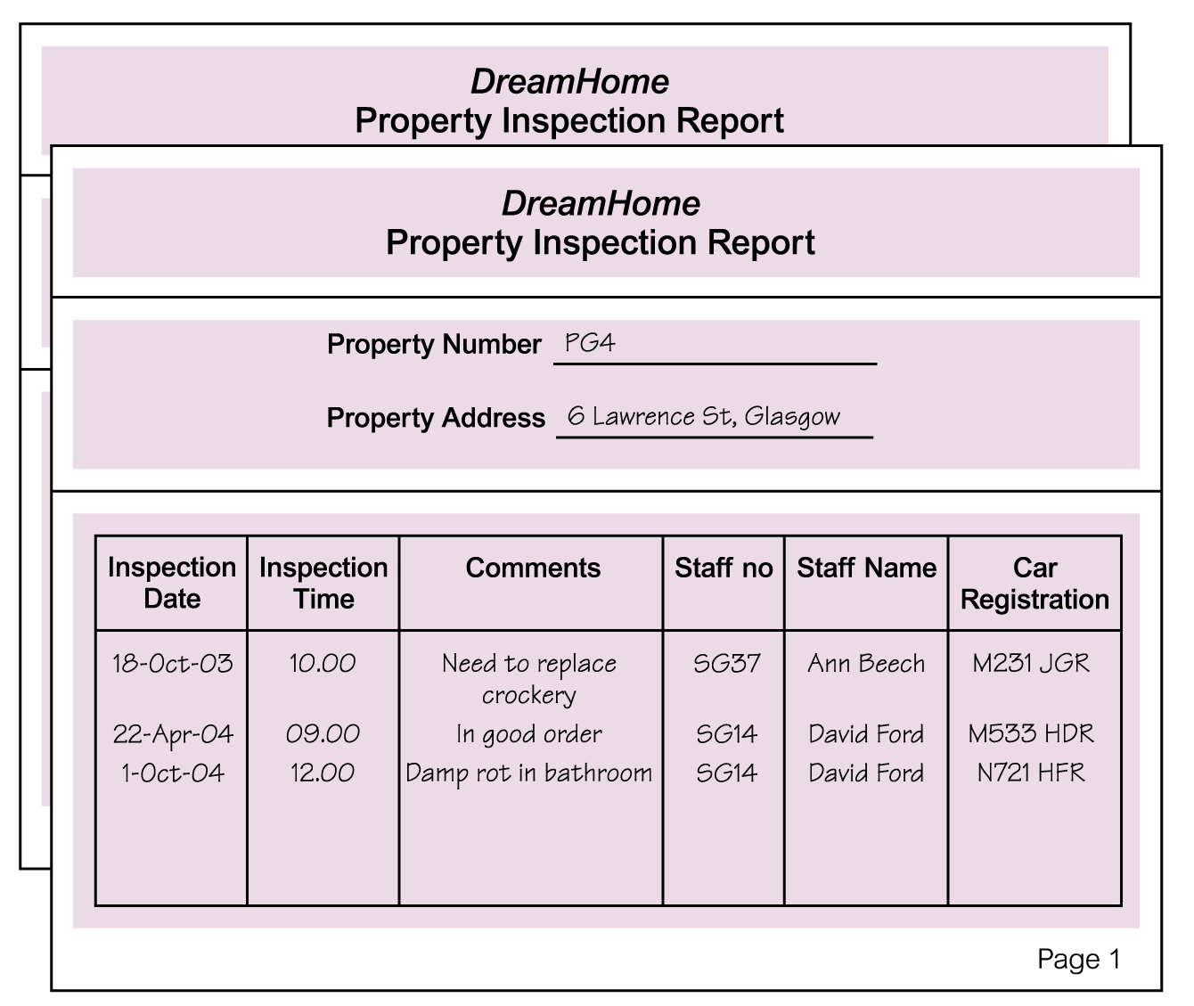
Review of Normalization (UNF to BCNF)

Slide 18
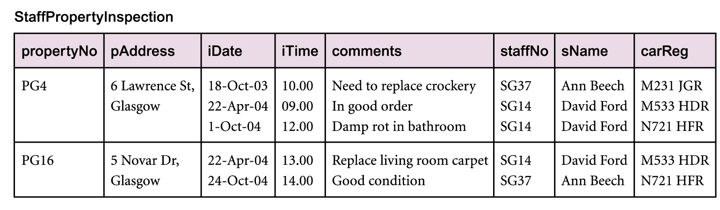
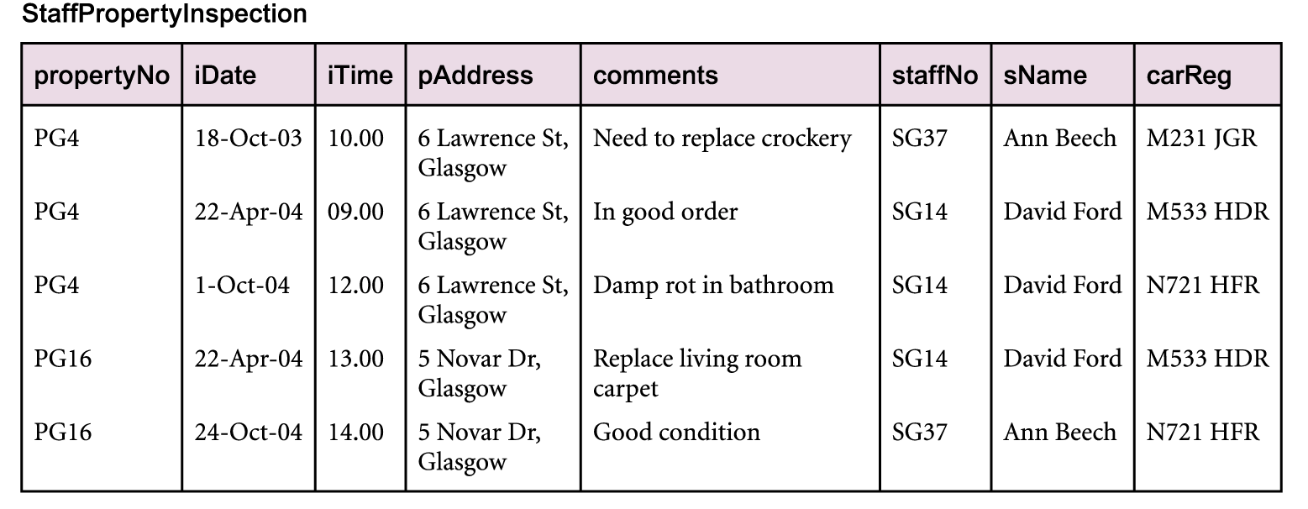
Review of Normalization (UNF to BCNF)

Slide 19
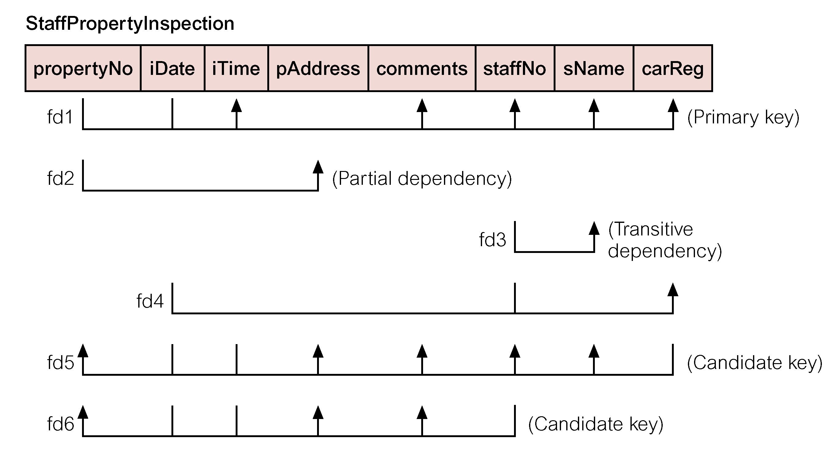
Review of Normalization (UNF to BCNF)

Slide 20
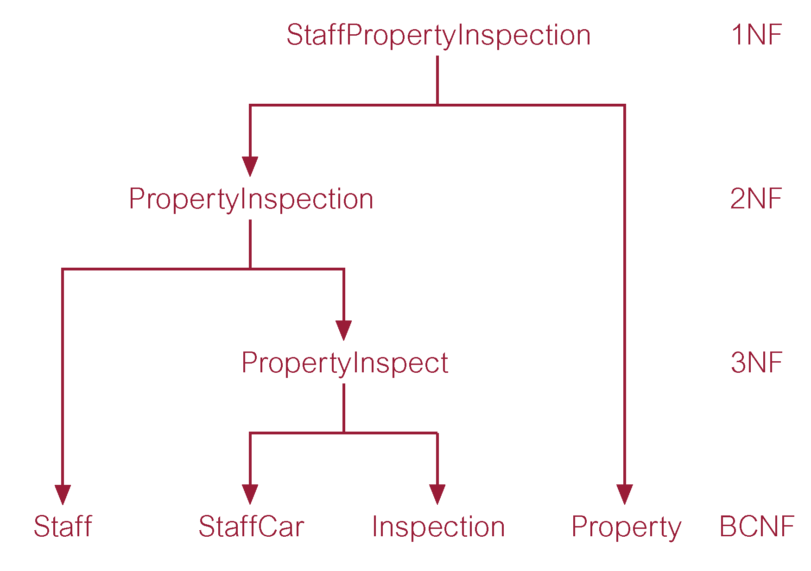
Review of Normalization (UNF to BCNF)

